Slide 1
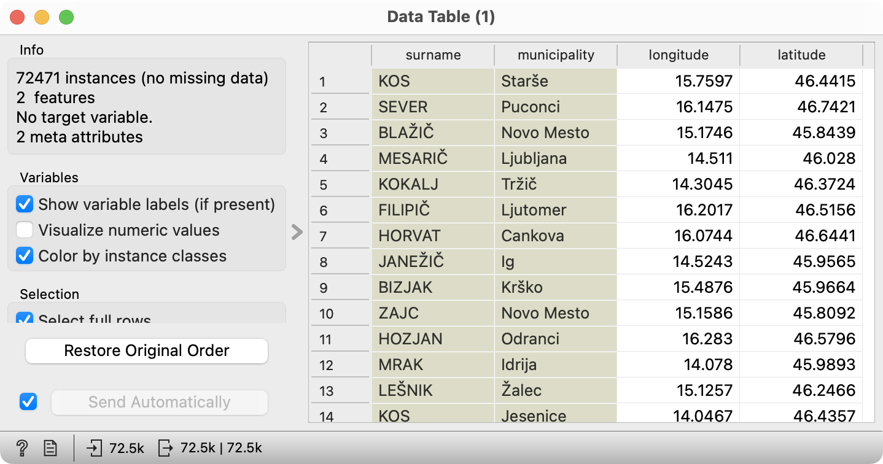
Surnames Challenge: The Data
The challenge begins with observing the data of the 200 most common surnames in Slovenia and the approximate location of the family bearing them.

Slide 2
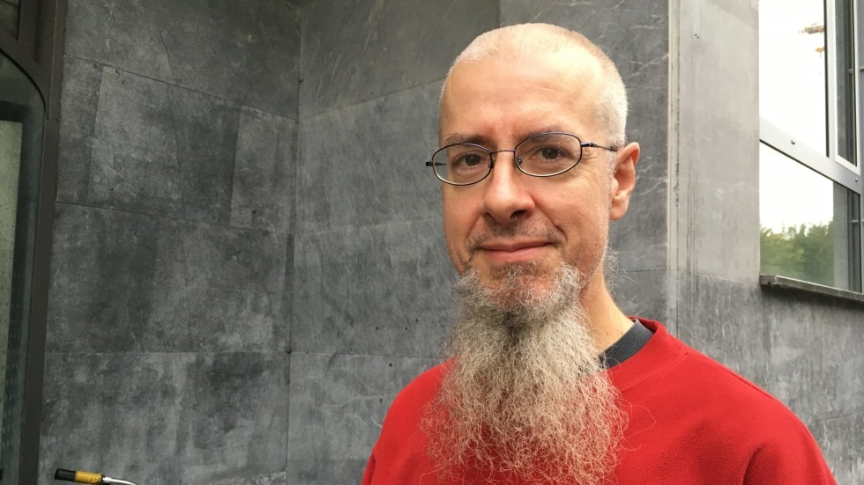
Surnames Challenge: The Data
Janez Demšar

Slide 3
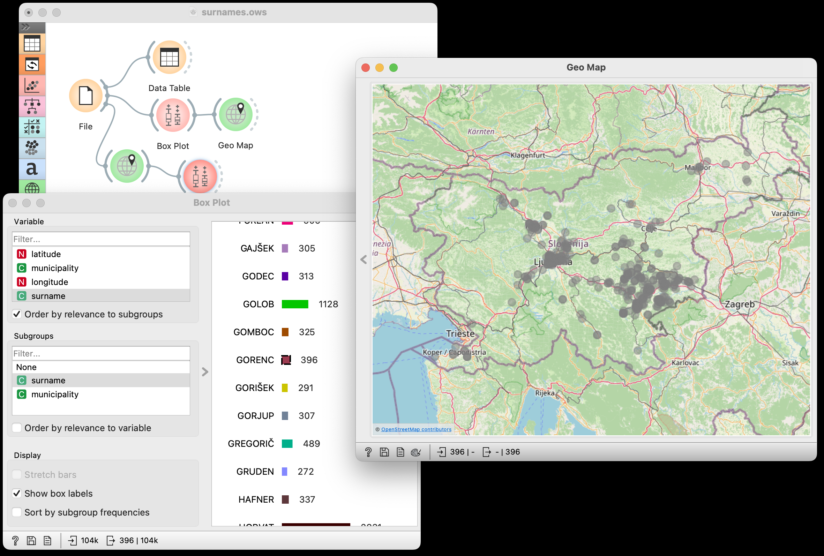
Location Mining
We can explore the geographic location of each of the surnames and notice an uneven distribution across the country.

Slide 4
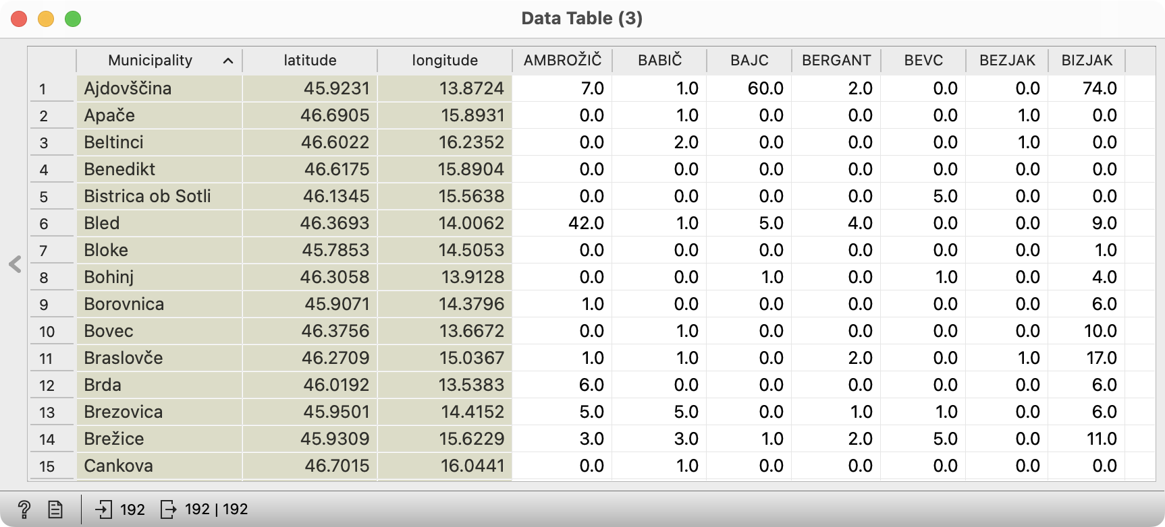
Surname-Based Municipality Profiling
We can profile municipalities based on the frequency of surnames…

Slide 5
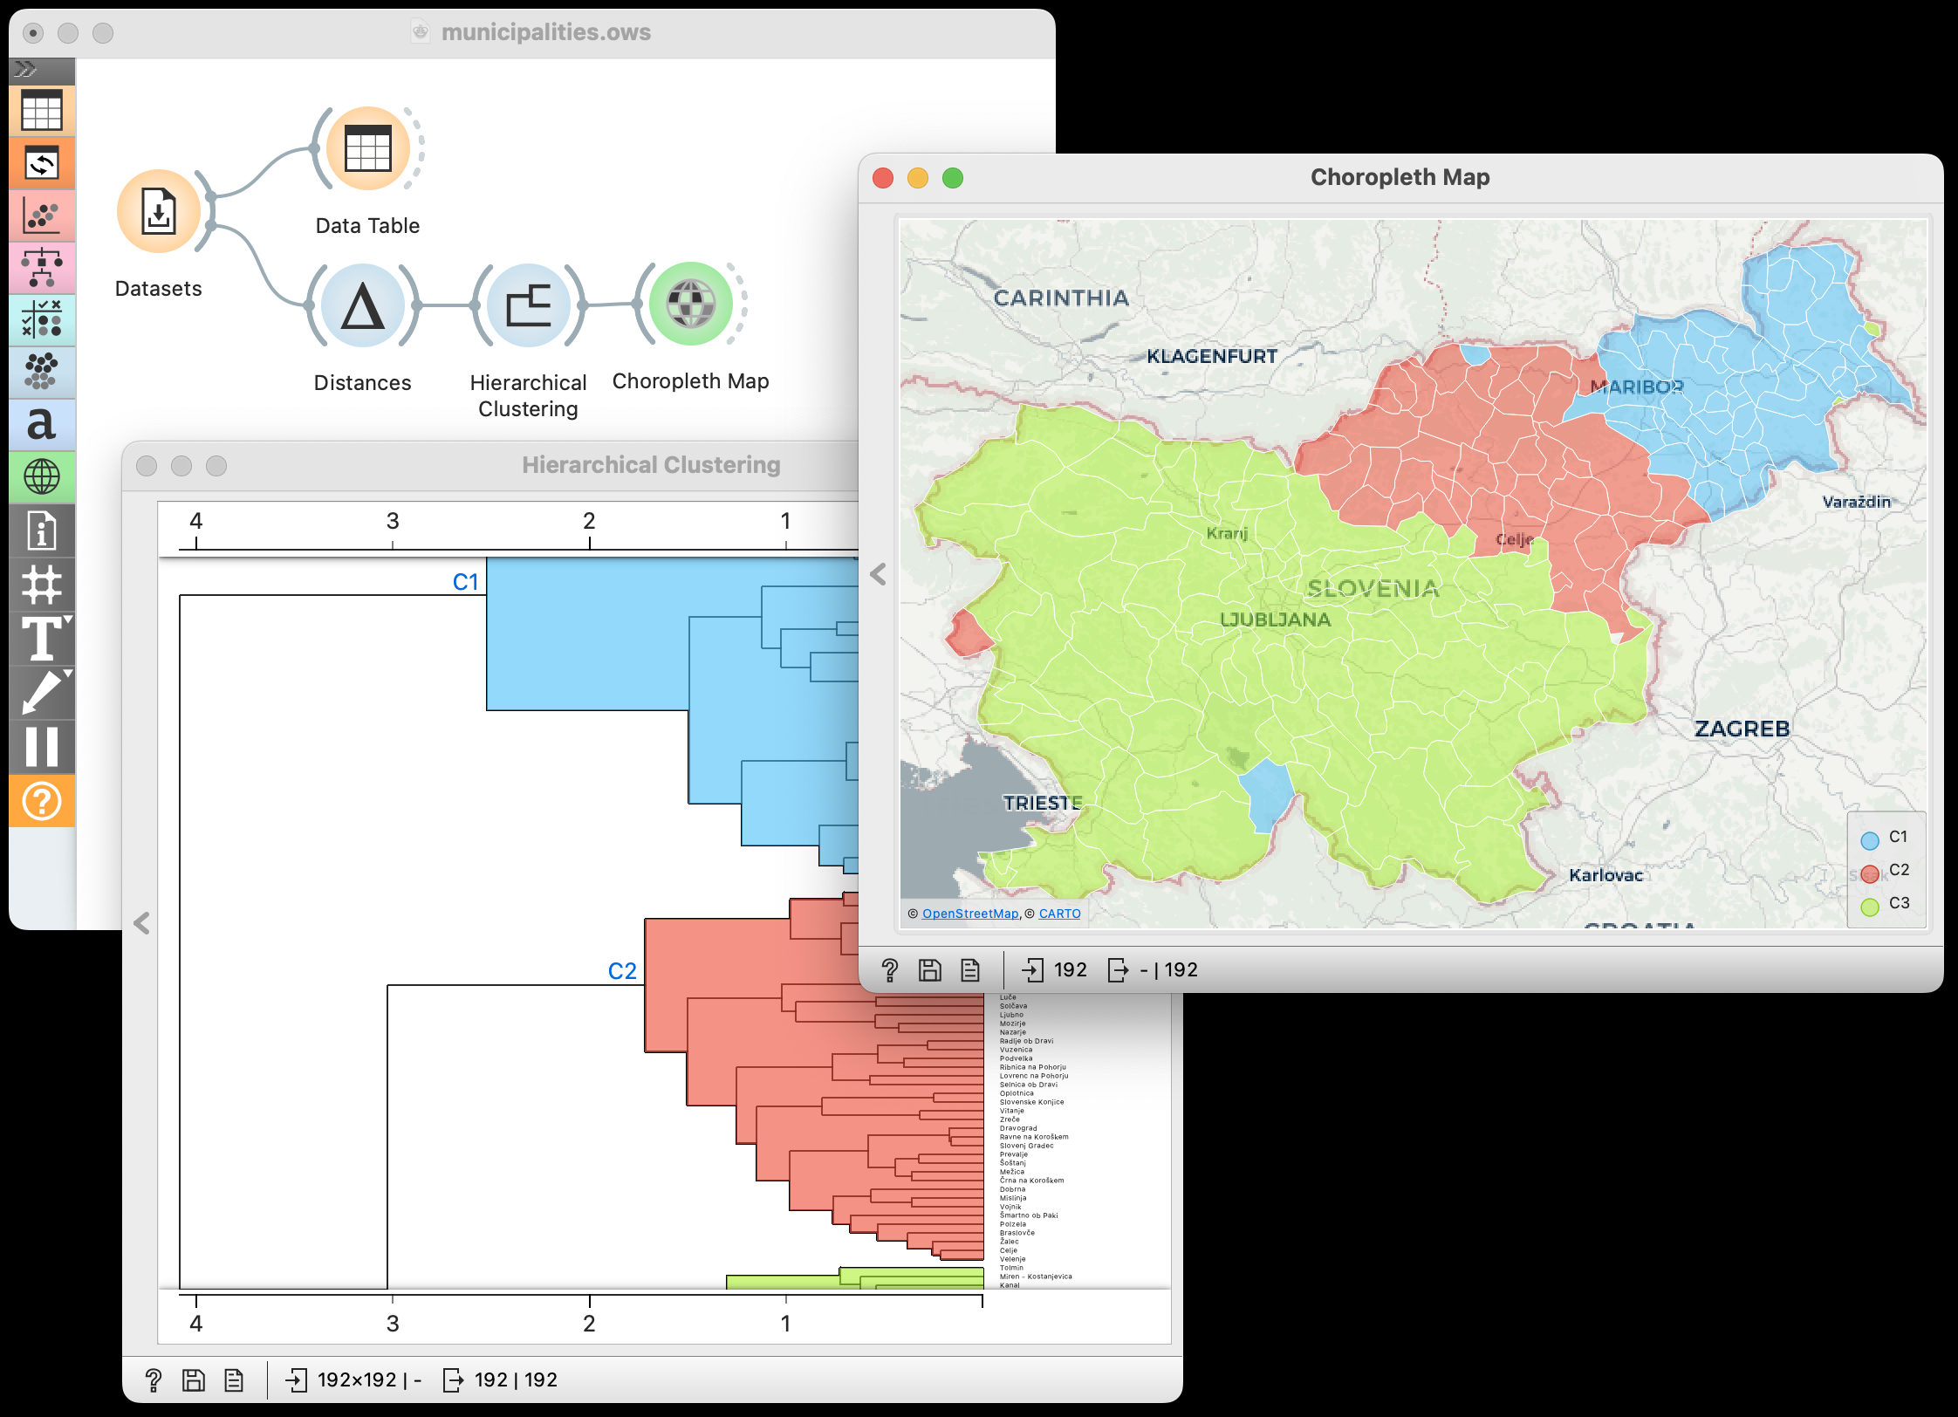
Clustering
…and then mine how similar they are.

Slide 6
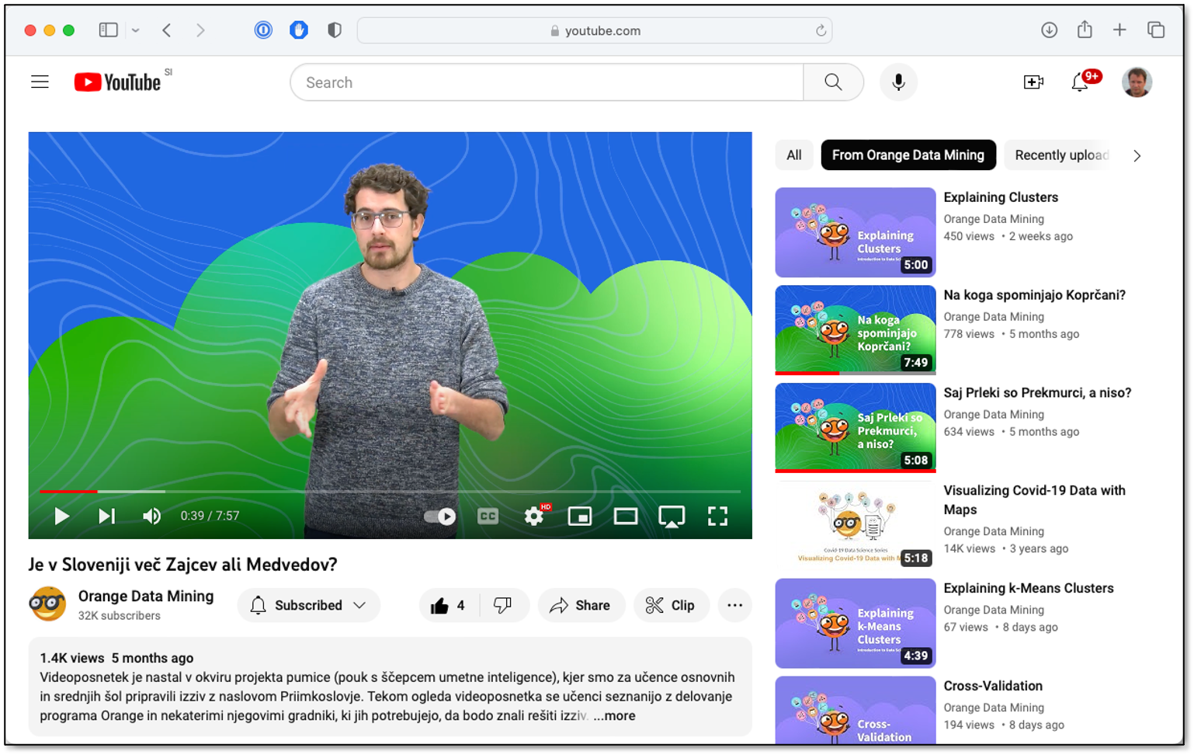
For the challenge, we have created a series of educational videos for children and teachers.

Slide 7
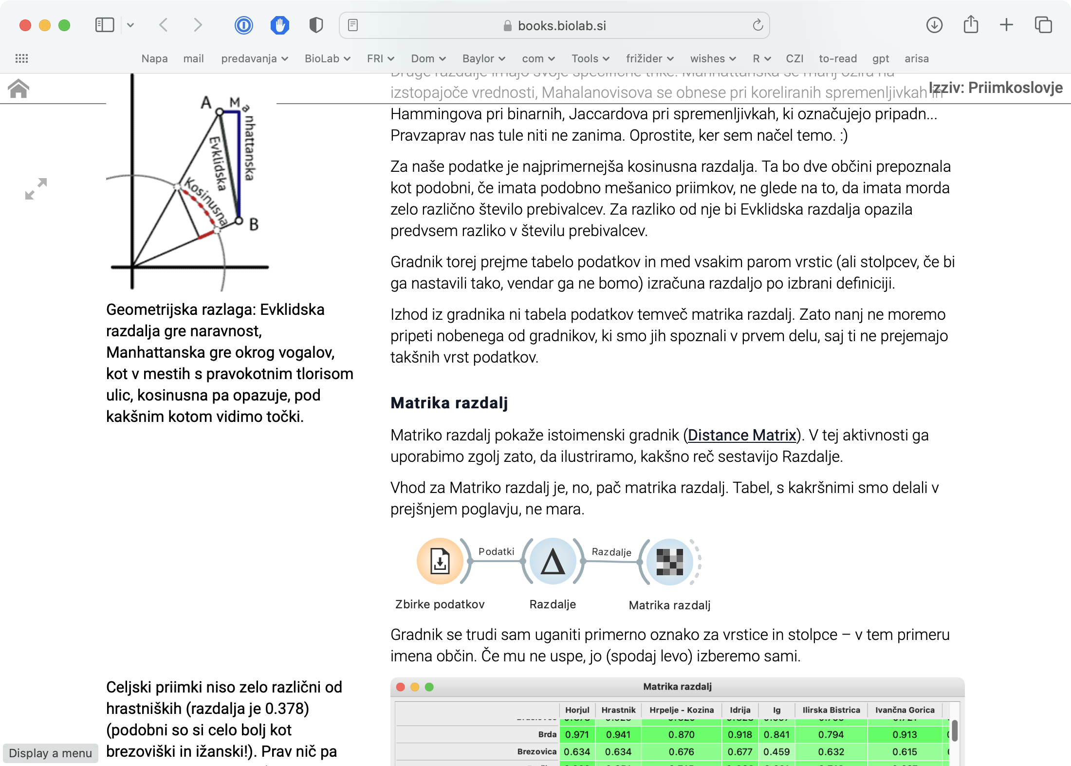
We have written a lecture notes that explain the challenge and background. For dedicated teachers only.

Slide 8
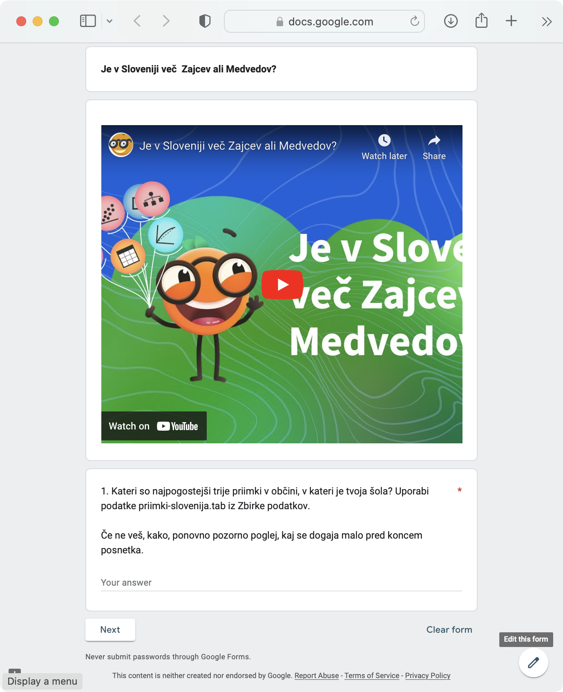
The challenge for the children was then a combination of videos and quiz questions.

Slide 9
We have trained the teachers about machine learning and went through the challenge.

Slide 10
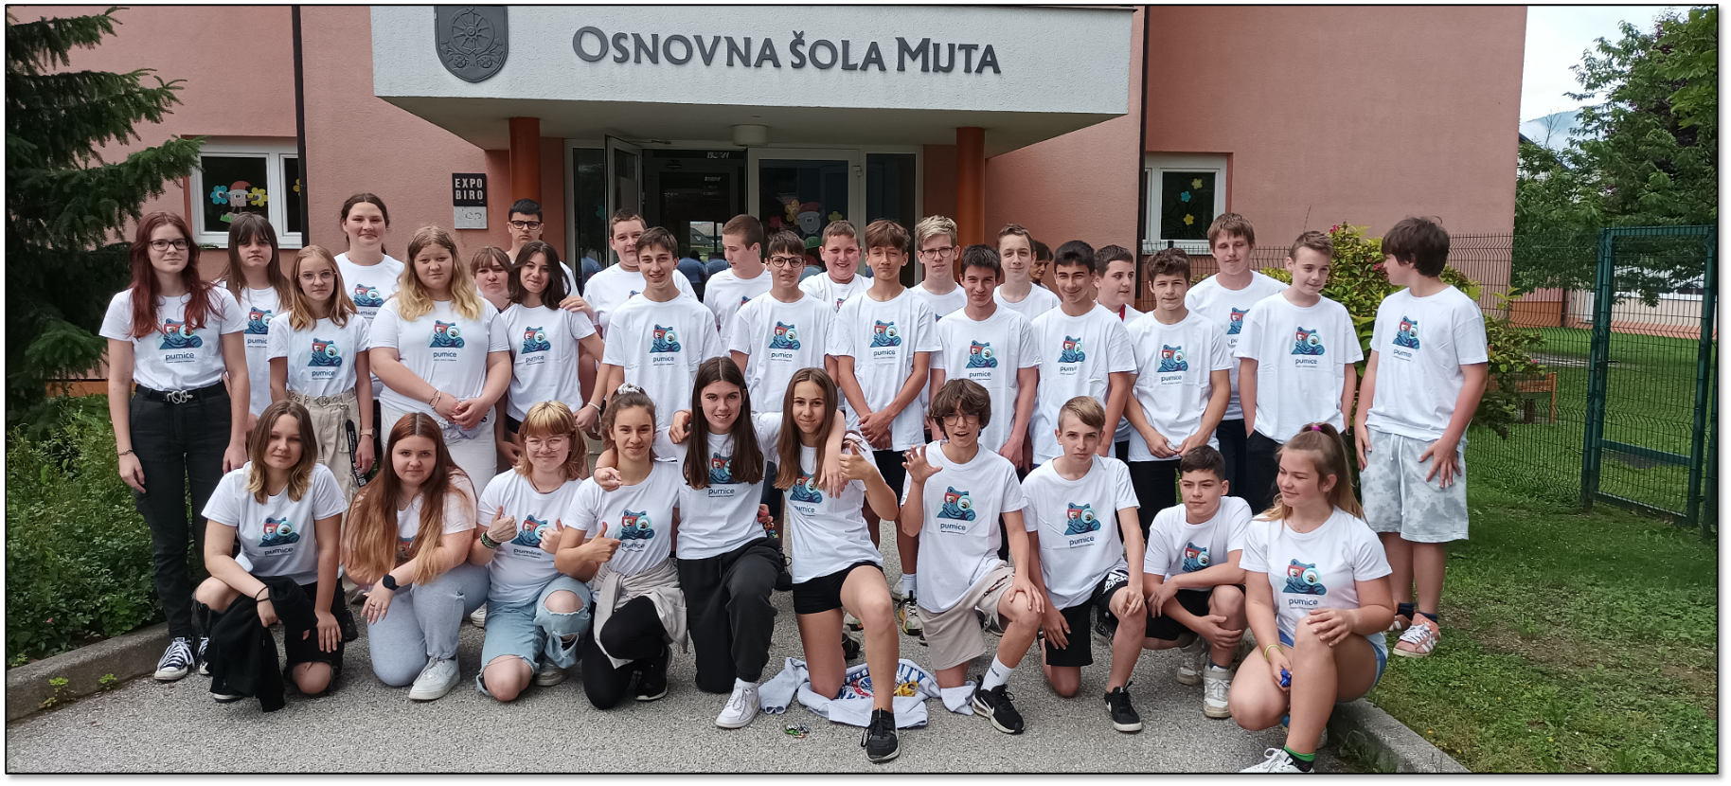
The challenged was carried out in May 2003, and engaged over 1.000 school kids all across Slovenia

Slide 11
Concepts Covered
Data
Data-based profiling
Estimation of distance
Nearest neighbors
Hierarchical clustering
Geoinformatics
The challenge, while only an hour long, covers many important machine learning concepts.

Slide 12
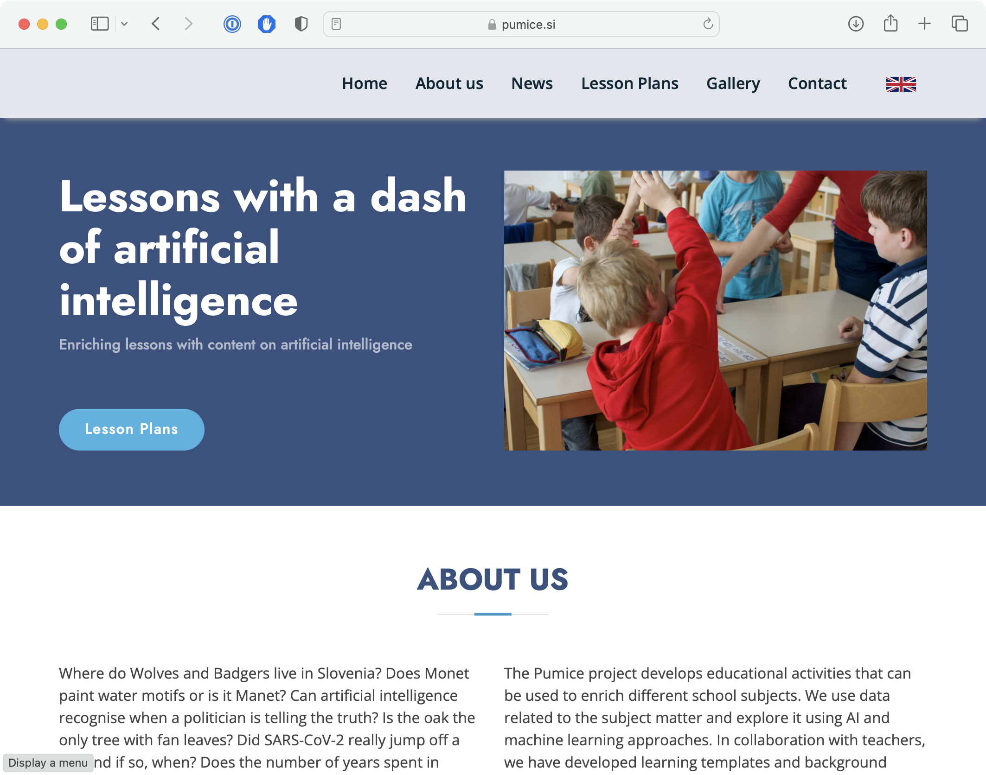
The material for this and other lectures is freely available online.

Slide 13
