Slide 1
How to not lie with charts
Helena Jambor, TU Dresden
helena.jambor@tu-dresden.de
Twitter: @helenajambor

Slide 2




Visualization for…
Data exploration
Data presentation
Data communication
290 226 47 35 116 25 297 57 171 1 189 157 72 102 0 27 44 155 179 71 105 99


Slide 3
K Z R
Q B T
S G N
Notes:
KZR
QBT
SGN
Time: 0.3 seconds
CONVEY INFO FAST
BUT: CAN BE SATURATED FAST TOO.
SATURATED: after SEVEN items!!!!

Slide 4
1. Visual perception is immediate
In less than 0.3 seconds we see:
Data Letters
Content KZR QBT SGN
Color White text on black
Layout 3 rows, 3 columns
K
Z
R
B
Q
T
Notes:
In fact Visual perception is not only immediate to us adults, but essentially innate.

Slide 5

2. Visual perception is innate
We use eye to compare…
Yummi!
Too much
Notes:
Everyone who has kids or smaller siblings, will know that they always want the biggest of everything. ..
then it becomes a chart.

Slide 6
3. Visualizations are learned
We use eye to compare…
Yummi!
Too much
Notes:
LEARNED, when we learn we must also learn what NOT to do and what does NOT work in visualilzaitons.

Slide 7
Visualizations can fail

Slide 8
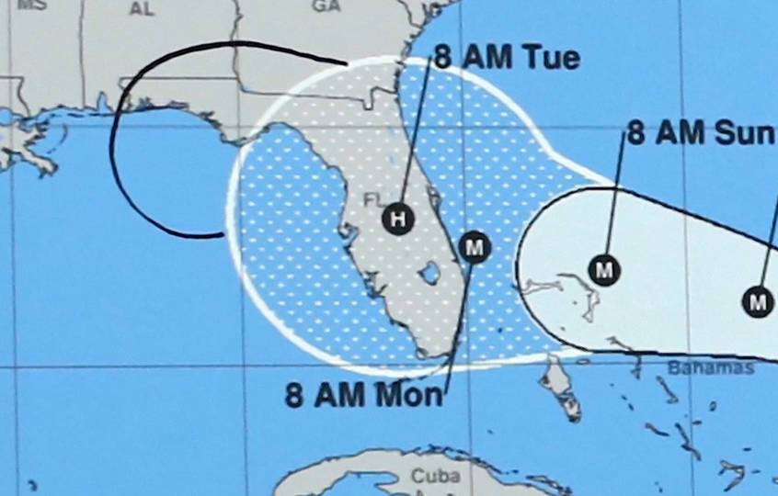
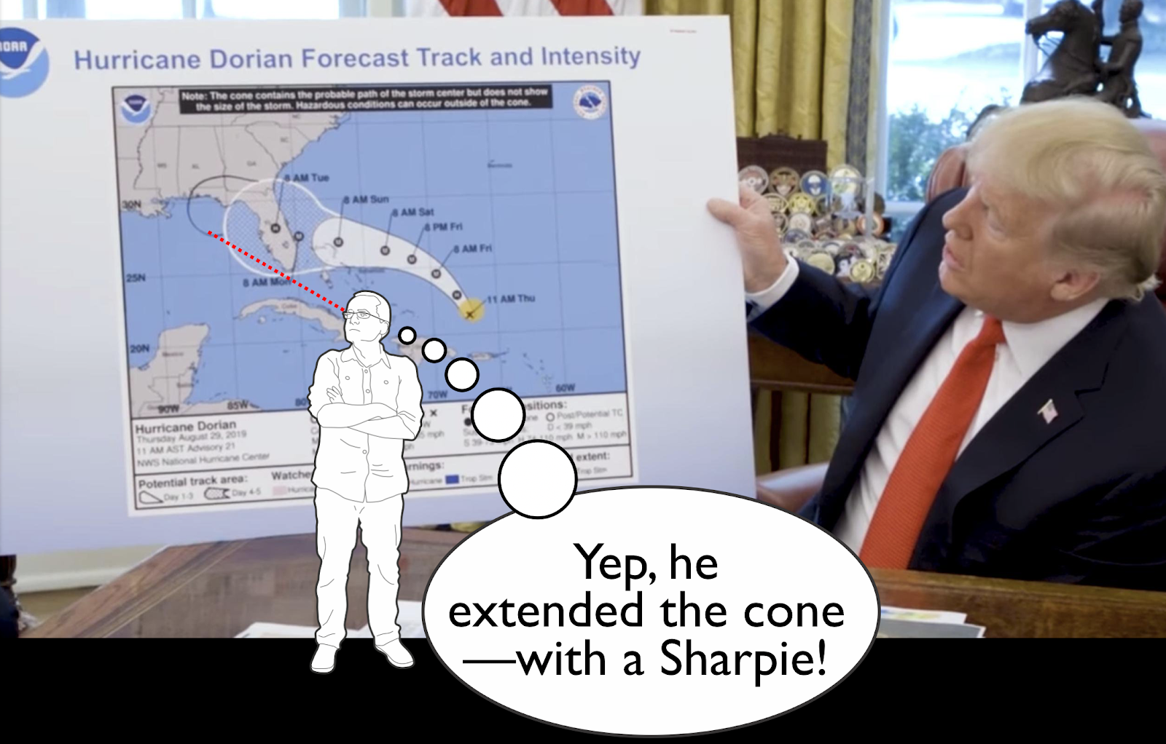
The White House, Alberto Cairo
pen!!
Notes:
This is the stuff that ends scientific careers

Slide 9
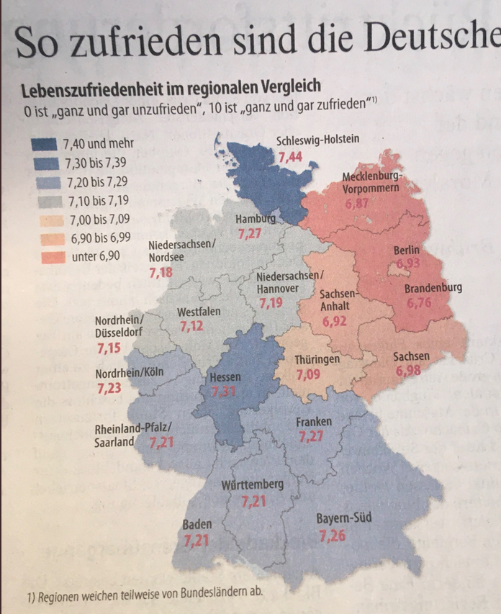

Slide 11
How to not lie with charts
10 tips

Slide 12
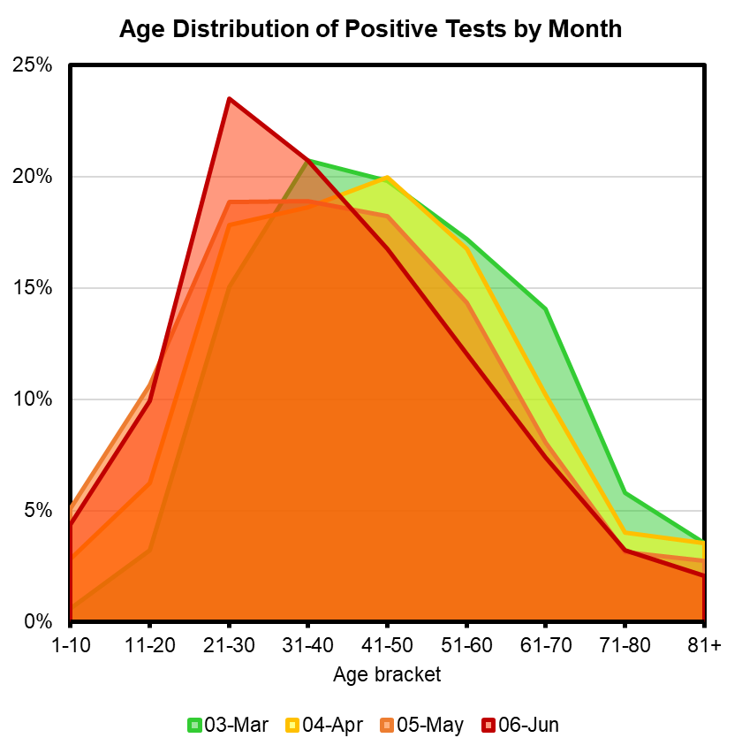
1. Pick a suitable chart type
21-30 yrs
31-40 yrs
11-20 yrs
61-70 yrs
March April May June
personal communication

Slide 13
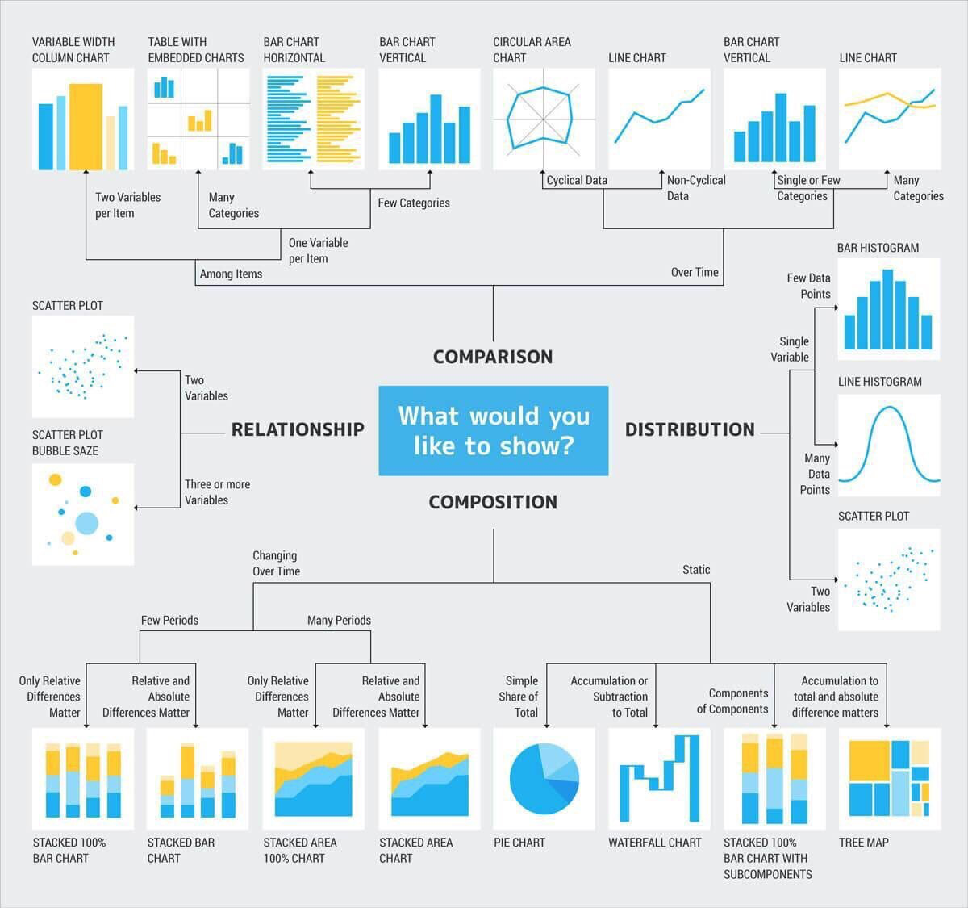
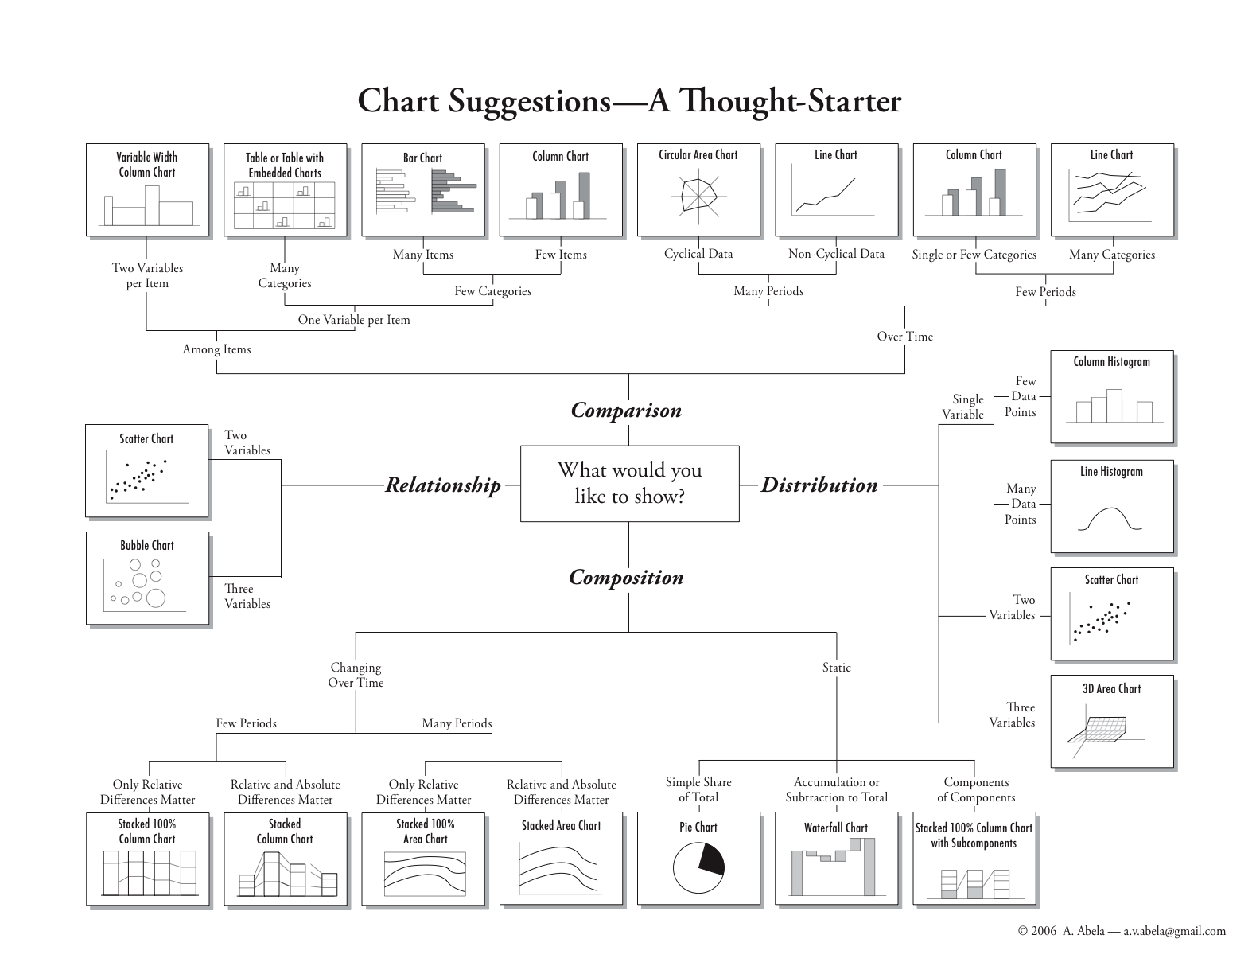
1. Pick a suitable chart type
Resources for choosing charts:
A.Abela

Slide 14
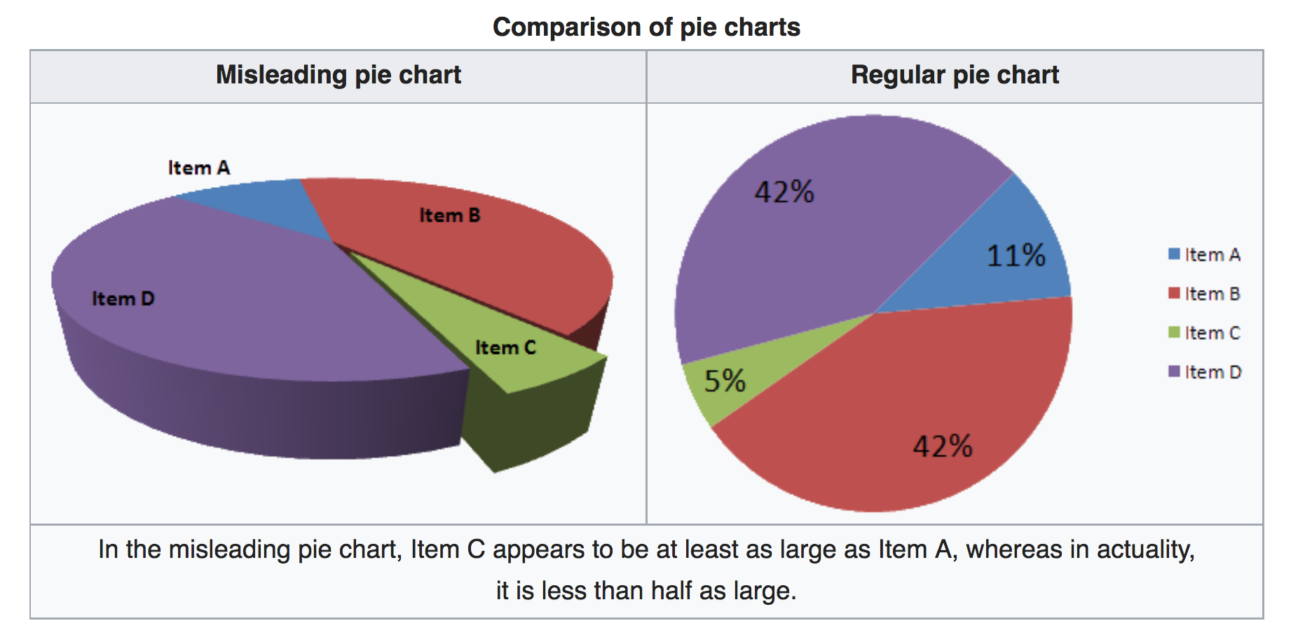
2. Avoid 3D charts

Slide 15
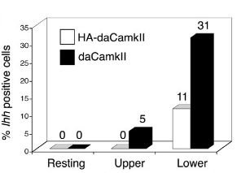
2. Avoid 3D charts
Eye sees this…
…but should read here

Slide 16
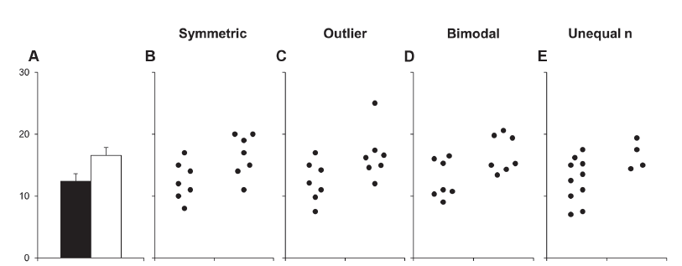
3. Show your data
Weissgerber et al., 2015, PLOS Biology
Notes:
In Panel B, although significant, there is substantial overlap
In Panel C, the apparent difference between groups is driven by an outlier.
Panel D suggests a possible bimodal distribution.
In Panel E, the smaller range of values in group two may simply be due to the fact that there are only three observations. Additional data for group two would be needed to determine whether the groups are actually different.

Slide 17
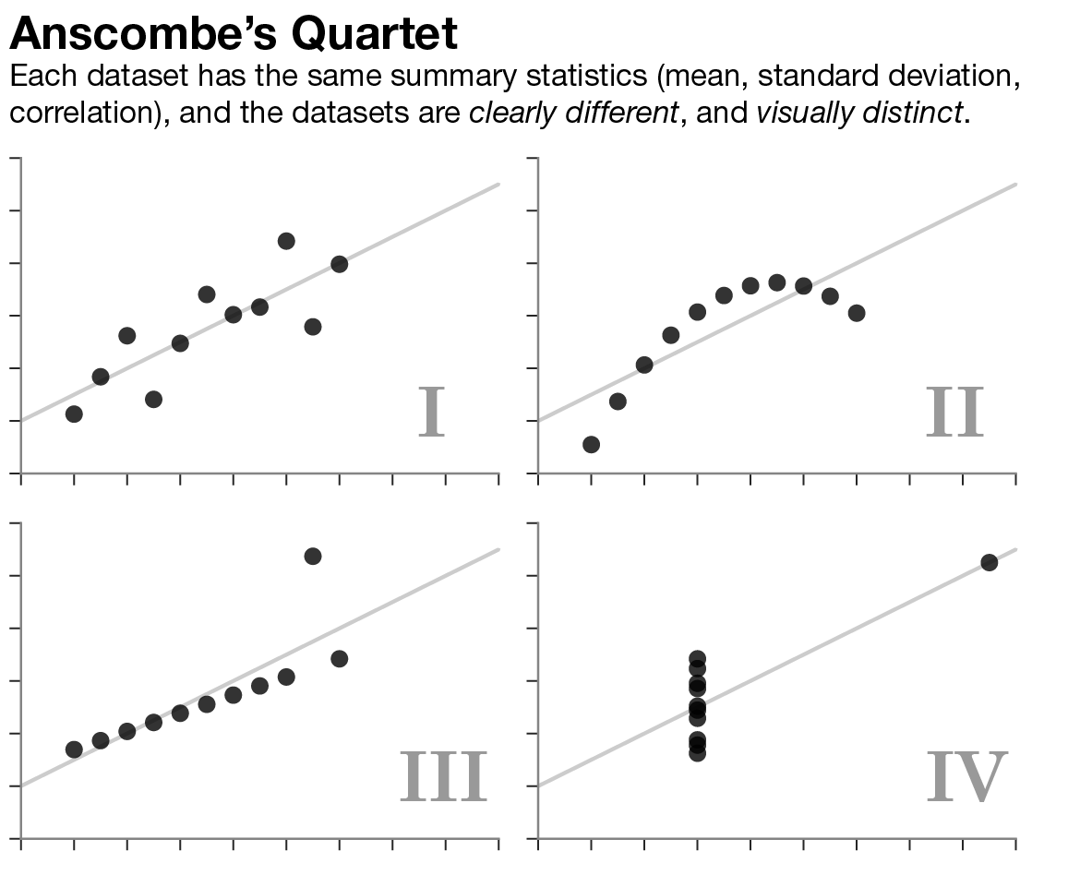
3. Show your data
Notes:
In Panel B, although significant, there is substantial overlap
In Panel C, the apparent difference between groups is driven by an outlier.
Panel D suggests a possible bimodal distribution.
In Panel E, the smaller range of values in group two may simply be due to the fact that there are only three observations. Additional data for group two would be needed to determine whether the groups are actually different.

Slide 18
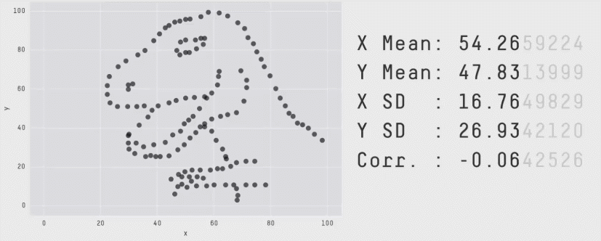
Alberto Cairo
Notes:
In Panel B, although significant, there is substantial overlap
In Panel C, the apparent difference between groups is driven by an outlier.
Panel D suggests a possible bimodal distribution.
In Panel E, the smaller range of values in group two may simply be due to the fact that there are only three observations. Additional data for group two would be needed to determine whether the groups are actually different.

Slide 19
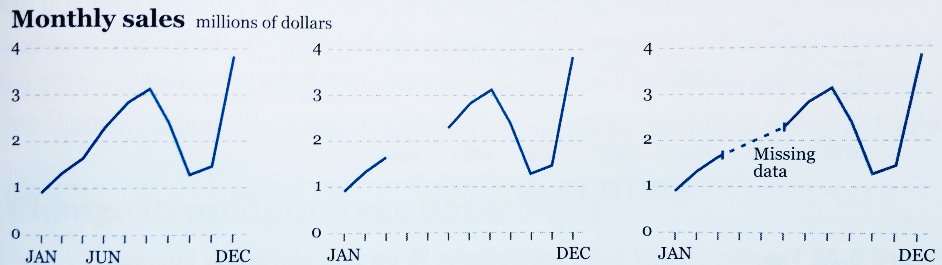
4. Indicate missing data
Misleading choice
Better choices
No line for highly
variable data
Dashed line for continuous data, e.g. growth of plants.
Alberto Cairo

Slide 20
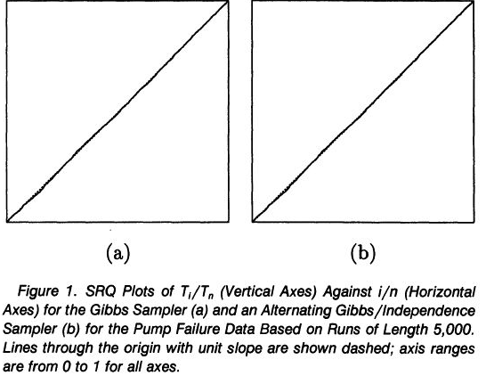
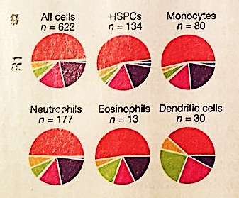
5. Label
What are the axes?
Color code?
Mykland 1995; nature, 2018, Vol 556, p. 109

Slide 21
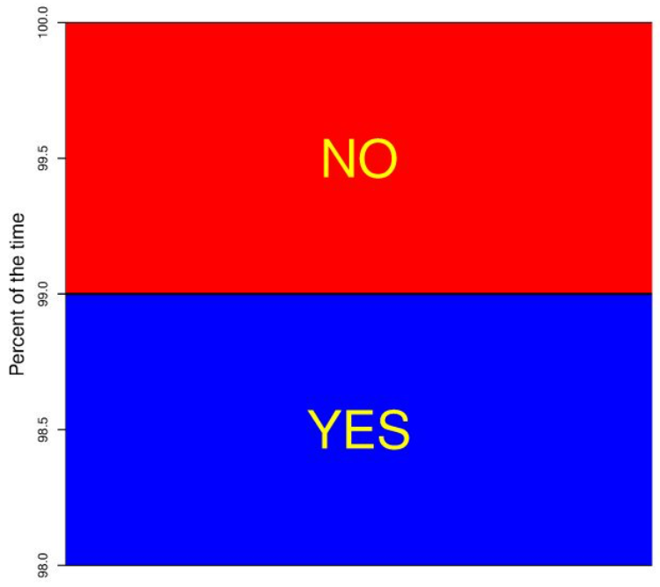
6. Bar charts need zero-baseline
Is a bar-chart without ZERO-baseline misleading?
Half say ‘yes’, half say ‘no’
%
NO
YES
98%

Slide 22
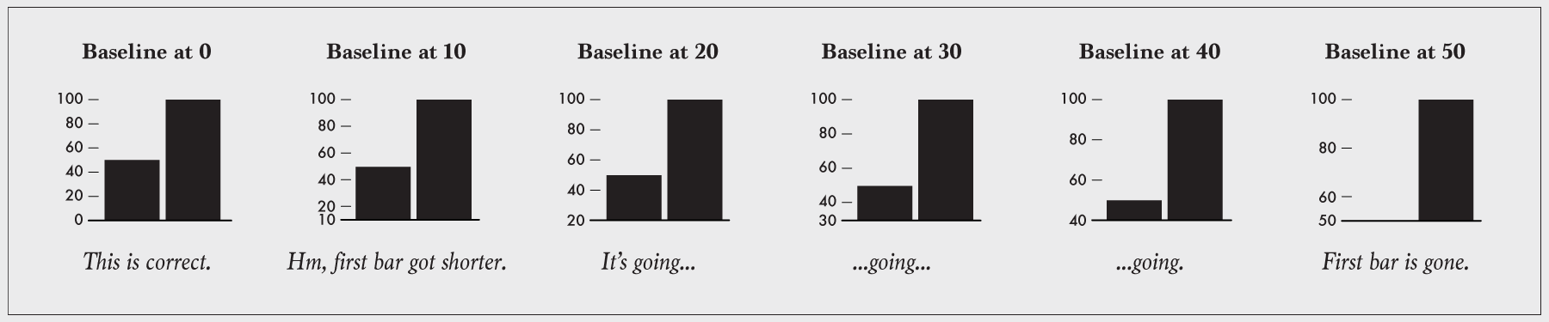
6. Bar charts need zero-baseline
Summary of the effect:
© flowingdata
Notes:
confusing
ambiguous
deceptive
mislead
fradu

Slide 23
7. Line charts may mislead with zero-baselines
Patient fever chart
…nobody has fever here!
Temp
ºC
Days

Slide 24
8. Think about axis layout
Patient fever chart, correctly focused on physiological range
90º
10º
45º
Change / trend is best visible at ~45 degree slope

Slide 25
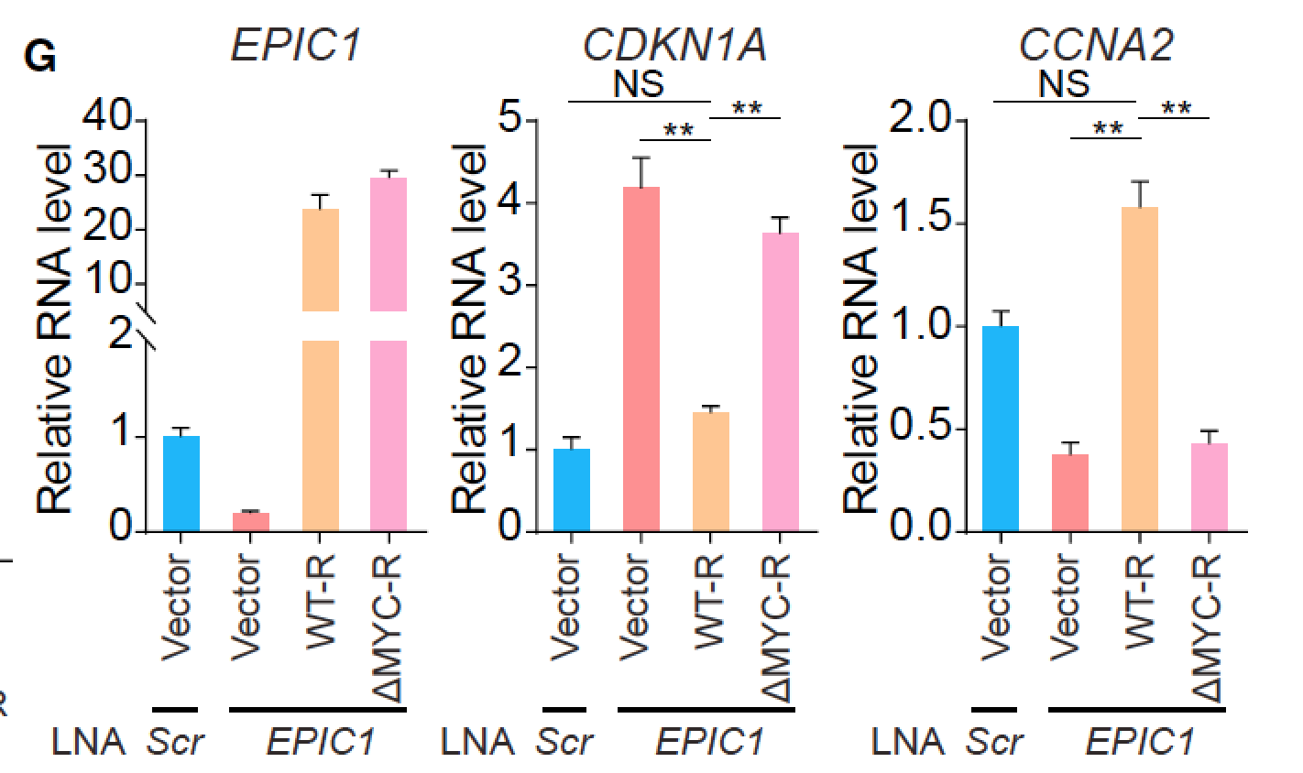
9. Avoid axis breaks
In fact….
axis breaks often not necessary
axis breaks are never intuitive

Slide 26
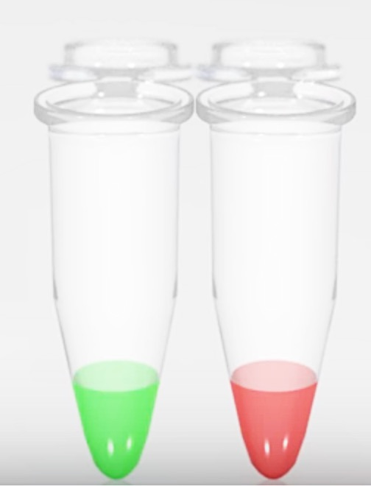
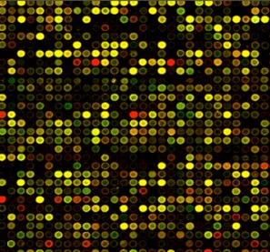
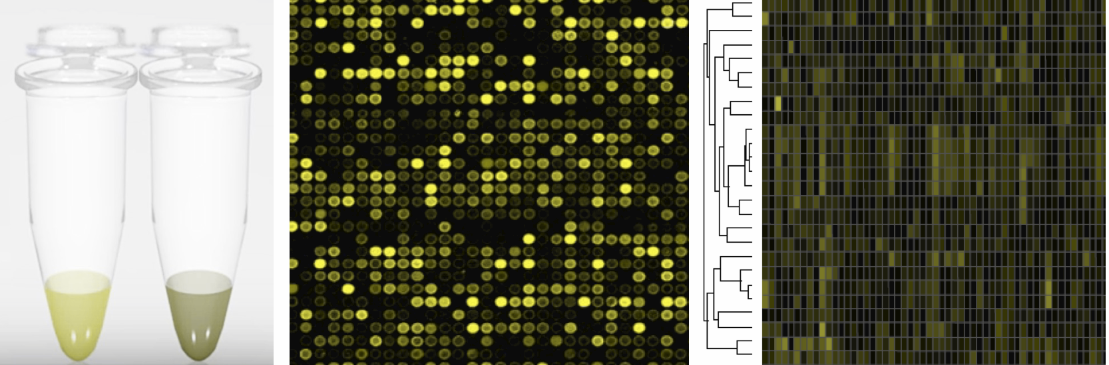
10. Pick suitable color
Microarray, gene expression changes before/after infection
10% of male audience sees it like this:
Do not use red & green in images/charts

Slide 27
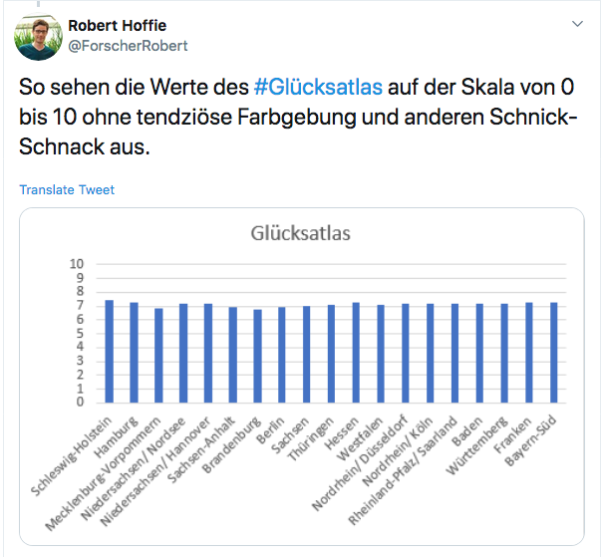
10. Pick suitable color
Happiness divide between East and West Germany?
Scale: 0 to 10
Data: 6.9 to 7.4…. all rather similar!
Notes:
While I am myself not from Eastern Germany, this still annoys me as a Data Scientists very much!

Slide 28
10. Pick suitable color
Happiness divide between East and West Germany?
Sequential values:
1 Color vary saturation
2 Colors for diverging values
Notes:
While I am myself not from Eastern Germany, this still annoys me as a Data Scientists very much!

Slide 29
10. Pick suitable color
Happiness divide between East and West Germany?
Sequential values:
1 Color vary saturation
2 Colors for diverging values
Categorical data
vary the hue
Notes:
While I am myself not from Eastern Germany, this still annoys me as a Data Scientists very much!

Slide 30
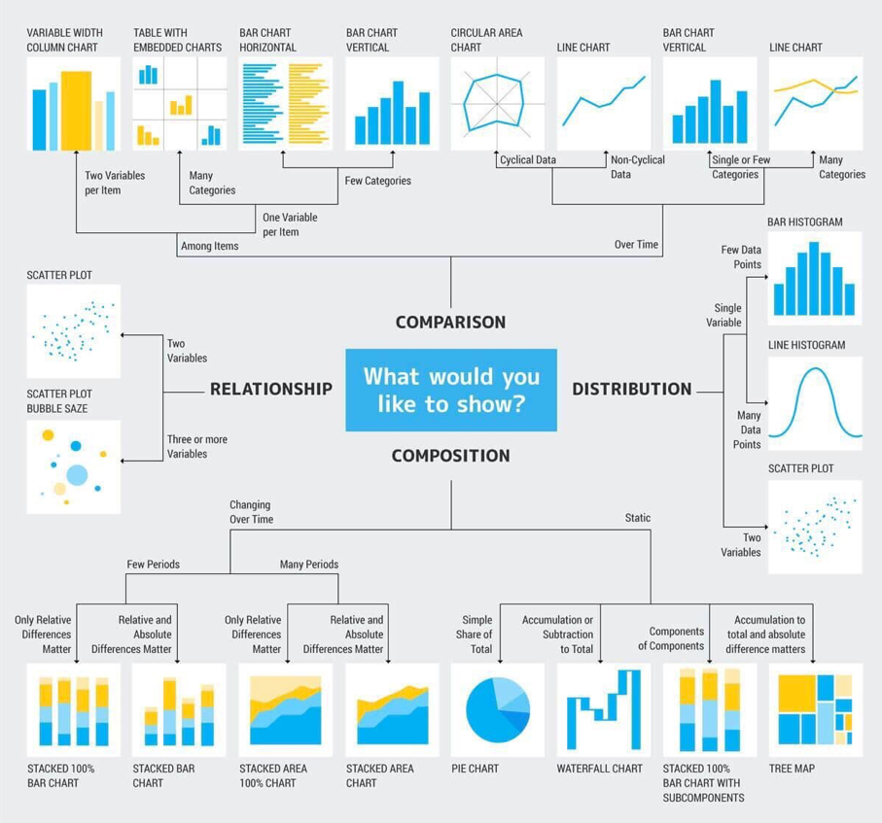
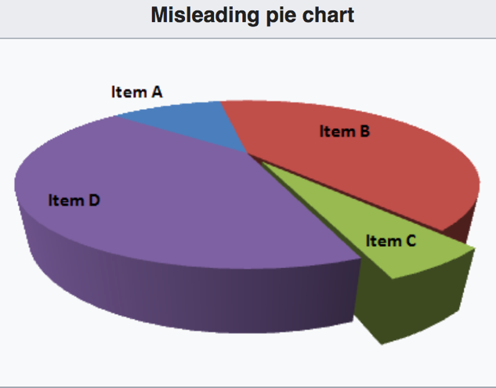
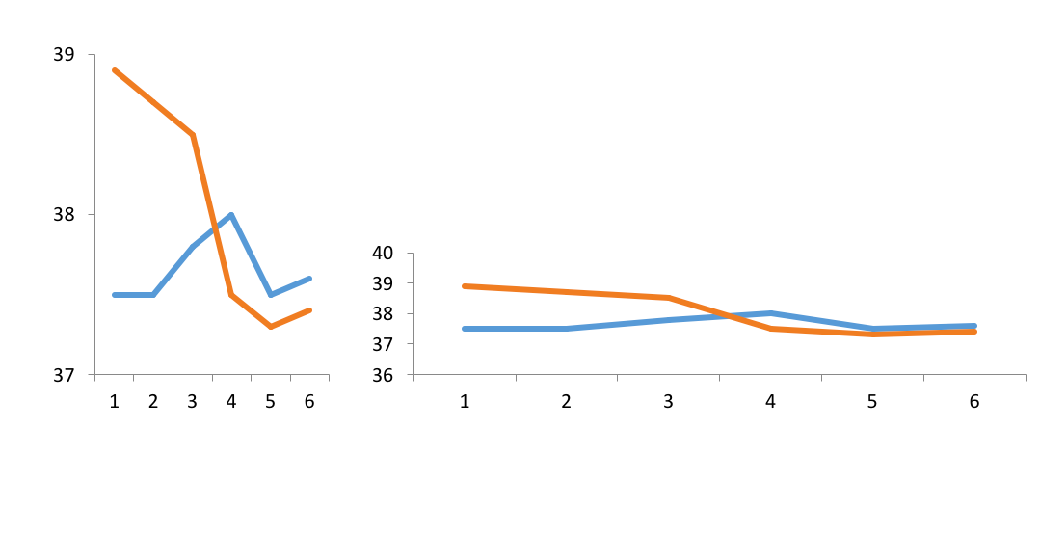
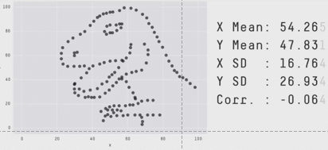
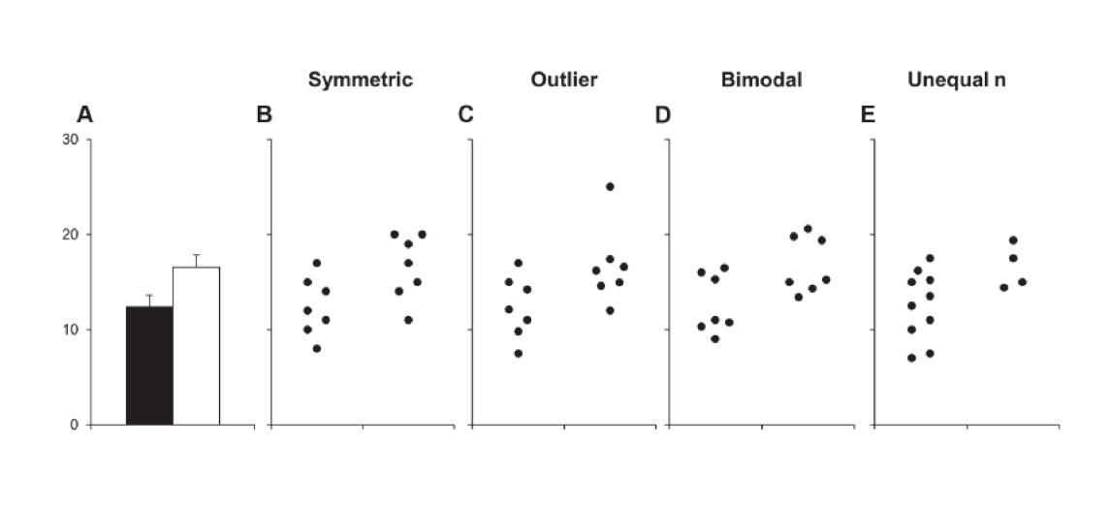
10 tips to not lie with charts
1
Pick suitable chart type
6
Bar charts need zero-baseline
2
No 3D charts
7
Line charts: focus on relevant range
3
8
Choose suitable axis layout
Show the data
4
Indicate missing data
9
Avoid axis breaks
☹
5
Label with text, avoid abbreviations
10
Pick accessible colors that are suitable to data type
© Helena Jambor

