Slide 1
Latent Dirichlet Allocation Simplified explaination of Gibbs Sampling without formulae.
dr. Ajda Pretnar Žagar
Text Mining course

Slide 2
Latent Dirichlet Allocation
Topic modeling is a text mining technique that elicits topics from documents.
Latent Dirichlet Allocation (LDA) uses word frequencies to determine topics (Pritchard idr. 2000, Blei, Ng in Jordan 2003).
Base premises:
each document is a mixture of a small number of topics
presence of the word in the document is directly related to one of the topics
Generative model (can generate new instances).
LDA ≠ Linear Discriminant Analysis

Slide 3
How LDA works
Algorithm first assigns topics to words in the document.
 | CHOLESTEROL | HDL | DIET | SMOKING
DOC1 | topic 1 | topic 2 | topic 2 | topic 1
DOC2 | topic 1 | topic 1 | topic 2 | topic 1
DOC3 | topic 2 | topic 1 | topic 1 | topic 2
DOC4 | topic 1 | topic 2 | topic 2 | topic 2

Slide 4
Algorithm counts, how many times a topic occurs in a document (left table) and how many times a topic is assigned to a given word (right table).
 | topic 1 | topic 2 |  |  | topic 1 | topic 2
DOC1 | 2 | 2 |  | CHOLESTEROL | 3 | 1
DOC2 | 3 | 1 |  | HDL | 2 | 2
DOC3 | 2 | 2 |  | DIET | 1 | 3
DOC4 | 1 | 3 |  | SMOKING | 2 | 2

Slide 5
Then the algorithm assumes that it doesn‘t know the topic for a given word.
 | CHOLESTEROL | HDL | DIET | SMOKING
DOC1 | ? | topic 2 | topic 2 | topic 1
DOC2 | topic 1 | topic 1 | topic 2 | topic 1
DOC3 | topic 2 | topic 1 | topic 1 | topic 2
DOC4 | topic 1 | topic 2 | topic 2 | topic 2

Slide 6
4. Next, it updates the tables from step 2. It re-computes frequencies of topics in documents (left table) and words in topics (right table).
 | topic 1 | topic 2 |  |  | topic 1 | topic 2
DOC1 | 1 | 2 |  | CHOLESTEROL | 2 | 1
DOC2 | 3 | 1 |  | HDL | 2 | 2
DOC3 | 2 | 2 |  | DIET | 1 | 3
DOC4 | 1 | 3 |  | SMOKING | 2 | 2

Slide 7
5. It computes how strong is the association between the document and the topic (probability of topic in the document: blue rectangle) and association between the word and the topic (probability of word in topic: grey rectangle).

Slide 8
6. The pink rectangle is the product of the blue and grey rectangles and represents the probability that a word belongs to a certain topic. Based on this probability (both pink squares), the technique then determines which topic the document will belong to (the green star, which represents the random assignment of a topic to the selected document based on the calculated probability of the word-topic combination).

Slide 9
In short, the algorithm determines a new topic (represented by the green star) based on probability (pink squares). The probability distribution of topics in the text is calculated using the Dirichlet distribution, which ensures that probabilities are never zero. This means that every word has at least a small chance of belonging to less common topics, or that less common topics are present in the document as well.
Once the algorithm assigns a topic to a word, it also updates the word-topic table.
 | CHOLESTEROL | HDL | DIET | SMOKING
DOC1 | topic 2 | topic 2 | topic 2 | topic 1
DOC2 | topic 1 | topic 1 | topic 2 | topic 1
DOC3 | topic 2 | topic 1 | topic 1 | topic 2
DOC4 | topic 1 | topic 2 | topic 2 | topic 2

Slide 10
Based on the new topic assignment from the table in step 6, the algorithm again updates the document-topic and word-topic tables.
 | topic 1 | topic 2 |  |  | topic 1 | topic 2
DOC1 | 1 | 3 |  | CHOLESTEROL | 2 | 2
DOC2 | 3 | 1 |  | HDL | 2 | 2
DOC3 | 2 | 2 |  | DIET | 1 | 3
DOC4 | 1 | 3 |  | SMOKING | 2 | 2

Slide 11
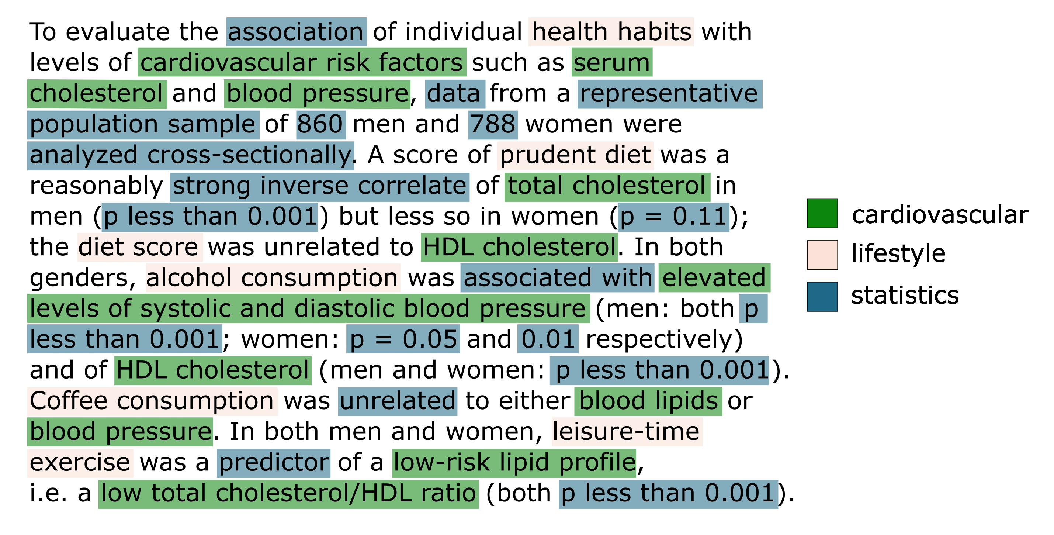
The process repeats until topic assignments stop changing. The result is a topic model. A topic is represented by a group of words that frequently co-occur in texts.

Slide 12
Characteristics of LDA
Topics are characterized by words that frequently co-occur in texts (a language-independent technique).
Each word can belong to multiple topics, typically with varying probabilities.
Topics appear with different frequencies in the corpus and are mutually independent.
The number of topics is predefined. The optimal number of topics for a given text is determined by the ease of defining meaningful themes that are still informative for the research problem at hand. Typically, the number of topics ranges from 5 to 50 (Arun et al., 2010), with many studies opting for 20 topics (Zhao et al., 2015; Gkoumas et al., 2018; Rosa et al., 2021).
The order of words within a text is not important (problematic).
The order of texts influences the results.

Slide 13
Limitations of LDA
LDA requires longer texts to function effectively. It is not suitable for topic modelling of tweets, user comments, or poetry.
Assumption of independence among words, texts, and topics.
LDA performs poorly if a text on a particular topic lacks coherence and only mentions it briefly.
The number of topics must be determined by the researcher's judgment and is typically the result of testing.
Difficulty in interpreting results of topic modelling. Qualitative reading is essential, and guidelines are necessary for collaborative decision-making.

Slide 14
LDA tools
Programming:
Gensim: Python library for topic modelling
Mallet: Java-based, popular
R: Text Mining package
GUI:
Voyant Tools: web-based
jsLDA: web-based
Orange Data Mining: LDA in Text Mining add-on

Slide 15
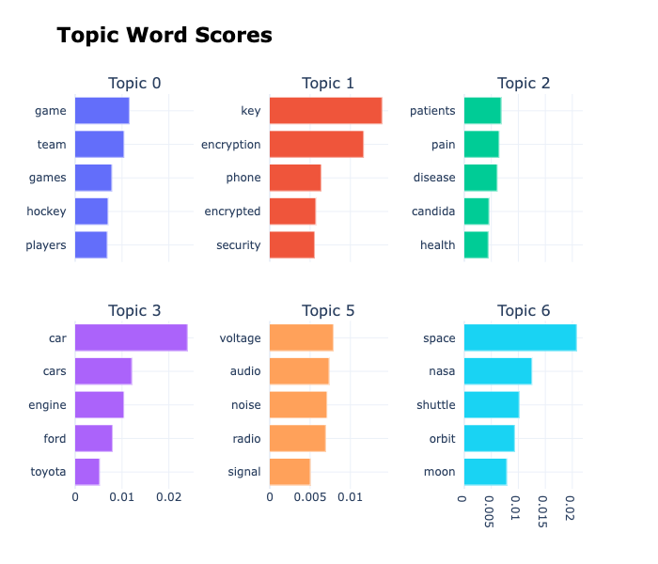
Beyond LDA
BERTopic: leverages BERT embeddings and HDBSCAN clustering to create coherent topic representations. It integrates the power of transformer models for capturing contextual word embeddings, leading to more accurate and meaningful topic discovery.

